Slide 1
WELCOME
Nelda M. Rodriguez, LMSW
UTRGV Social Work Deparment
Office: SWOT 1.218
Tele: (956) 665-3190
email.: nelda.rodriguez@utrgv.edu

Slide 2
How Do I know? What Do I Do?: Recognizing Signs of Child Abuse

Slide 3
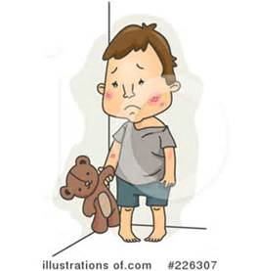
Child Abuse/Neglect
Objectives:
Definition
Indicators
Reporting
Scenarios

Slide 4
What is Child Abuse?
The mistreatment of a child by an adult
Physical abuse is a physical injury that results in substantial harm to the child, such as bruises, fractures, or death. It also can include a genuine threat of harm even if there is no visible injury.
Sexual abuse is sexual conduct harmful to a child's mental, emotional, or physical welfare. This includes fondling a child's genitals, penetration, indecent exposure, and exploitation through producing pornography.
Emotional abuse is an action that results in a marked impact on a child's growth, development, or psychological functioning. Emotional abuse includes extreme forms of punishment such as confining a child in a dark closet, habitual scapegoating, or belittling to the point that it results in noticeable effects on the child's daily functioning.
Labor trafficking means to knowingly use a child for labor or services by force, fraud, or coercion. This includes obtaining the child for personal use OR providing the child to others. It involves the exchange of monetary or nonmonetary benefits, including the child's services. Labor or services involving sexual conduct is sex trafficking.
Sex trafficking means to knowingly use a child for illegal sexual conduct. This includes obtaining the child for personal use OR providing the child to others. It involves the exchange of monetary or nonmonetary benefits, including the child's services. Sex trafficking occurs even if the child seems complicit or does not believe he or she is a victim. Prostitution is a form of sex trafficking.

Slide 5
What is Child Abuse?
Physical injury or the genuine threat of substantial harm can come from actions such as hitting, kicking, biting, shaking, choking, or any other violent act against a child. This definition does not include an accident or reasonable discipline that does not expose the child to a substantial risk of harm.
An individual can also commit abuse under The Texas Family Code External Link by:
Causing or permitting a child to be in a situation in which he or she sustains a mental or emotional injury
Failing to make a reasonable effort to prevent physical or sexual conduct that is harmful to a child
Compelling or encouraging a child to engage in sexual conduct
Using a controlled substance in a manner or to the extent that it results in physical, mental or emotional injury to a child
Causing, permitting, or encouraging a child to use a controlled substance

Slide 6
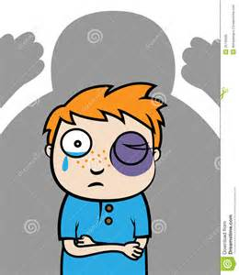
Scope of the problem
The impact of abuse is far greater than its immediate visible effects
Abuse and neglect are associated with short and long term consequences that may include brain damage, developmental delays, learning disorders, problems forming relationships, aggressive behavior and depression

Slide 7
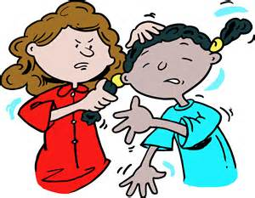
Survivors of child abuse and neglect may be at greater risk for problems later in life such as:
a. low academic achievement
b. drug use
c. teen pregnancy
d. criminal behavior
These behavior not only affect the child and family, but society as a whole.

Slide 8
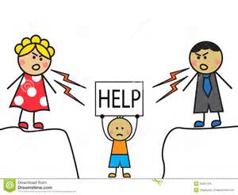
Fatalities
Each day in the United States more than 3 children die as a result of child abuse in the home
Most children that die are younger than 6 years of age
More children (age four and younger) die from child abuse and neglect than any other single, leading cause of death for infants and young children.

Slide 9
Statistics
By age 18, 1 in 4 girls and 1in 6 boys have been sexually abused
It is estimated that 100,000- 500,000 children are sexually abused each year
85% of sexual assaults on children are committed by someone the child knows and usually trusts
Child abuse knows no boundaries. It happens in every class, race, ethnic group, educational and economic group. No family is immune.
A report of child abuse is made, on average, every 10 seconds.
Girls are sexually abused 4x’s more often than boys, while boys are a greater risk of emotional neglect and serious injury
Women sexually abused before age 18 have lower levels of interpersonal function and social adjustment as adults and are less likely to form trusting relationships.

Slide 10
Who is likely to be abused?
Boys and girls are almost equally likely to experience neglect and physical abuse
50% of victims are White
25% of victims are African American
15% of victims are Hispanic
2% of victims are American Indian/Alaska Natives
1% of victims are Asian/Pacific Islanders

Slide 11
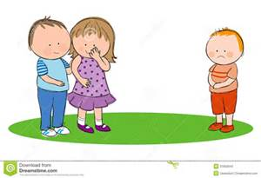
Types of Child Abuse
Neglect 63%
Physical 19%
Sexual 10%
Emotional 8%

Slide 12
Physical Abuse
Physical Indicators
Unexplained bruises
Burns/bruises in unusual patterns
Human bites
Broken bones
Missing hair
Scratches
Frequent complaints of pain w/o obvious reasons
Behavioral Indicators
Wary of physical contact with adults,
Behavioral extremes (aggressive or withdrawn)
Frightened of parents
Afraid to go home
Cheating
Stealing
Lying( a sign that expectations in the home are too high
Layered clothing
Lack of reaction to pain

Slide 13
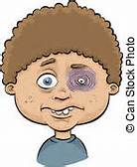
Examples of Physical Abuse
Hitting biting
Choking shaking
Kicking missing/loosened teeth
Biting burning
Slapping injuries inflicted with objects
beating

Slide 14
Emotional Abuse Definition: Parental behavior such as rejecting terrorizing, ignoring, or isolating a child
Physical Indicators
*speech disorders
*lags in physical development
*failure to thrive
Behavioral Indicators
*habit disorders (sucking, biting, rocking
* Conduct disorders (withdrawal, destructiveness, cruelty)
* sleep disorders or inhibition of play
*behavior extremes (aggressive/passive)

Slide 15
Examples of emotional Abuse
Ignores child’s physical/emotional needs
Rejection/withdrawal of love
Terrorizes/threatens child
Cruel, bizarre/inconsistent punishment
Isolates/restricts child for long periods
Denies child food, shelter, or sleep as a punishment
Corrupts child by encouraging antisocial/unacceptable behavior

Slide 16
Neglect Defined as: Failure of a parent or caretaker to provide needed, age appropriate care including food, clothing, shelter, protection from harm, hygiene, and medical care.
Physical Indicators
Obvious malnourishment
Poor hygiene
Obvious fatigue and listlessness
Lack of appropriate supervision
Unattended physical problems
Or medical needs,
Abandonment
Inappropriate clothing for weather conditions
Behavioral Indicators
Begging or stealing food
Frequent sleepiness
Lack of appropriate supervision
Unattended physical problems
Or medical needs,
Abandonment
Inappropriate clothing for weather conditions
Frequent absence or tardiness from school

Slide 17
Sexual Abuse Defined as: any inappropriate sexual exposure or touch by an adult to a child or another child to a younger child
Physical Indicators
Difficulty in walking/sitting
Torn/stained/bloody underclothing
Pain/itching in genital area
Bruising or bleeding in rectal/genital area
Venereal disease
Behavioral Indicators
Age-Inappropriate sexual knowledge/sexual touch
Abrupt change in personality
Withdrawn
Poor peer relationships
Unwilling to change for gym or participate in physical activities
Promiscuous behavior/seductive behavior
Drop in school performance/decline in school interest
Sleep disturbances
Regressive behavior( i.e. bedwetting)

Slide 18
Examples of sexual abuse
Fondling
Indecent exposure
Showing pornographic materials
Touching sexual organs (child/or adult)
Attempted or actual sexual intercourse
Child prostitution
Incest

Slide 19
Characteristics of Potentially Abusive Neglectful Adults
Poor parenting skills
Unreasonable expectations for child
Undue fear of spoiling the child
Parental attitudes/religious beliefs in necessity for harsh physical discipline
Multi-generational history of violence or domestic abuse
Stresses such as marital problem, presence of extended family members
Lack of social contact
Unemployment
Poor housing and financial problems
Severe emotional pressure or mental illness

Slide 20
Influence of Substance Use
Nearly ½ of substantiated cases of child neglect and abuse are associated with parental alcohol or drug use
It is estimated that 1 in 4 children in the US ( 28 million) are living in a household with an alcoholic adult
Men and women serving time in the nation’s prisons and jails report a higher incidence of abuse as children than that of the general population.

Slide 21
Who abuses Children? Where does it happen?
Most often the abuser (perpetrator) is someone the child knows, such as a parent, neighbor, or relative
Child abuse usually happens in the child’s own home
Sometimes it happens in other settings, such as child care centers, schools, flea markets, malls etc.

Slide 22
Three Major Components of Child Abuse
Child
+
Caregiver
+
Stress
=
Child Abuse

Slide 23
Stressors Associated
With the child……
An unwanted child
A hyperactive child
A child that reminds the parent of someone they do not like (father, mother, etc.)
A low birthweight child
With the parent……
Abused as a child
Single parent
Absent spouse
Divorce
Alcohol/drugs
Emotional immaturity
Postpartum depression
Unrealistic expectations
Stress of unemployment
Mental illness
Low self esteem

Slide 24
Prevention tips to share with parent
Never discipline child when your anger is out of control
Participate in the child’s activities and get to know the friends
Never leave a child unattended especially in a car
Teach the child about good/bad touches
Don’t force the child to be with a person they don’t want to be with. If they say something about that person check it out before you dismiss their reason
Be aware of changes in child’s behavior and attitude
Teach the child what to do should they be separated from you in a public area
Pay attention when someone pays greater than normal interest in the child
Make sure the school/daycare only release the child to persons you designate

Slide 25
5 R’s of Child Abuse
1. Raise the issue
2. Reach out to kids and parents in your community
3. Remember the risk factors
4. Recognize the warning signs
5. Report suspected abuse or neglect

Slide 26
What you need to consider…
Don’t try to conduct an investigation yourself
If the child tells you of the sexual abuse immediately after it occurred; Do not bathe the child, change his/her clothes or wash the clothes
Let the child talk as much as he/she wishes.. Pay close attention to detail
Understand that the child may be having mixed emotions about the incident
Believe the child
Explain what you will do next to help them

Slide 27
How can you tell abuse/accidents? Location of Injury
Common accidental injuries locations
knees,
Elbows
Shins
foreheads
Suspicious locations
the protected body parts and soft tissue areas:
Face
Back
Thighs
Genital areas
Buttocks
Back of legs

Slide 28
How can you tell abuse/accidents?
Accidental Injuries….
Have a reasonable explanation.
Non-Accidental Injuries……
1. May leave a print/pattern of a shoe, belt buckle, brush, a cigarette burn,
2. Do not have a reasonable explanation

Slide 29
Reporting Requirement
The statute(law) requires that anyone who know or has reasonable cause to believe a child is neglected or abused must immediately report it to their local Department for Social Service Office (Texas Department of Family and Protective Services) , law enforcement agency or a reporting hotline

Slide 30
How do you report suspected abuse/neglect?
Contact the Child Protective Services hotline
1-800-252-5400
2. Child Protective Services website
https://www.txabusehotline.org
3. Call local law enforcement

Slide 31
Failure to Report Texas Family Code,Chapter 261, 261, 101
Requires that professionals such as teachers, doctors, nurses, or child daycare workers must make a verbal report within 48 hours. Failure to report suspected child abuse or neglect is a misdemeanor punishable by imprisonment of up to 180 days and/or a fine of up to $2,000.

Slide 32
What Information do you need to make report?
Child’s Identity: name, address, age and location
Name and address of the child’s parent, guardian, or person with custody
Date, nature and extent of abuse or neglect
The identity of the person(s) suspected of abusing or neglecting the child
Any other information helpful in determining the cause of the child’s injury/neglect

Slide 33
What happens when you make the report?
Your report will be screened to see if enough information exists to conduct an investigation
Investigators respond within a particular time period
Investigators may speak with the child, parent, and other people in contact with the child
Their purpose is to determine if abuse/neglect has occurred and if it may happen again
If they find no abuse/neglect the case is closed
If the investigator feels the child is at risk of harm the family may be referred for services to reduce the risk of harm and develop a safety plan
If the investigator feels that there is high risk of harm to the child he/she may remove the child from the home to ensure safety

Slide 34
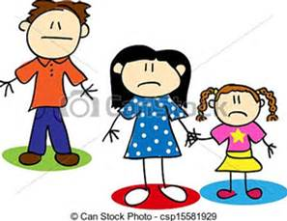
Case Scenario for Reporting

Slide 35
Questions?
Thank you

